Slide 1
STOCK PRICE PREDICTION OF NIFTY 50 COMPANIES
Presented By :
Bhopatrao Nihal (Roll no. 5)
Kumbhare Sanket (Roll no. 36) Wankhede Shashank (Roll no. 60)
Guide By : Prof. A. S. Kunte

Slide 2
Problem Statement:
Creating a website which will be able to predict future price of certain company out of Nifty 50 companies using deep learning techniques in the form of table or graph

Slide 3
DESCRIPTION
What is Nifty 50? A stock is the certain amount of ownership in company. Basic goal of this project is to use deep learning to make prediction of stock price. This project focuses on NIFTY 50 companies only. We are going to implement deep learning algorithm know as long short-term memory (LSTM) which is based on Recurrent Neural Network (RNN).

Slide 4
OBJECTIVES
To implement LSTM model which will be train on available historical data.
To forecast the next 30 days price of stock of particular NIFTY 50 listed company in which user is interested.
To integrate this model in order to develop simple system through which user can interact and perform predictions as per his requirements i.e company name and number of predictions.
To provide insights of data in graphical format such as bar charts,line chart,comparison between predicted vs actual,accuracy of prediction etc.

Slide 5
SCOPE
The project is focuses on applications of model(LSTM) for stock price prediction.
In this project we are considering only NIFTY 50 listed companies as their historical data and real time data are easy to fetch.
To predict stock price user will have option of uploading dataset of that company
User will be able to make prediction of next 30 days.

Slide 6
Time Series Forecasting
Time Series Forecasting is type of problem in machine learning or deep learning
When we want to make prediction over the period of time we consider it as time series forecasting problem and these predictions may be sales or revenue after 1 -2 months or price of stock of a company or any arbitrary value which make some sense in real world

Slide 7
Time Series Forecasting Algorithms
Autoregression (AR)
Moving Average (MA)
Autoregressive Moving Average (ARMA)
Autoregressive Integrated Moving Average (ARIMA)
Seasonal Autoregressive Integrated Moving-Average (SARIMA)
Seasonal Autoregressive Integrated Moving-Average with Exogenous Regressors (SARIMAX)
Vector Autoregression (VAR)
Vector Autoregression Moving-Average (VARMA)
Vector Autoregression Moving-Average with Exogenous Regressors (VARMAX)
Simple Exponential Smoothing (SES)
Holt Winter’s Exponential Smoothing (HWES)
Naïve, Snaïve
Exponential smoothing
TBATS
Prophet
NNETAR
LSTM

Slide 8
Choosing Algorithm
Blog Article
Research papers
Websites
Youtube Videos

Slide 9
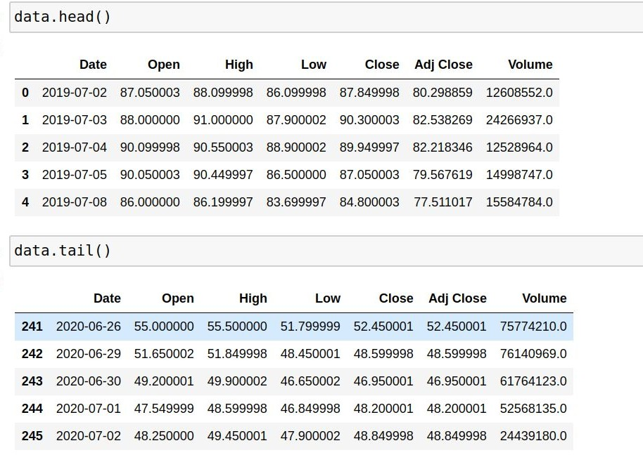
Using Simple Linear Regression
We used dataset of Ashok leyland for from 2019 to April 2020

Slide 10
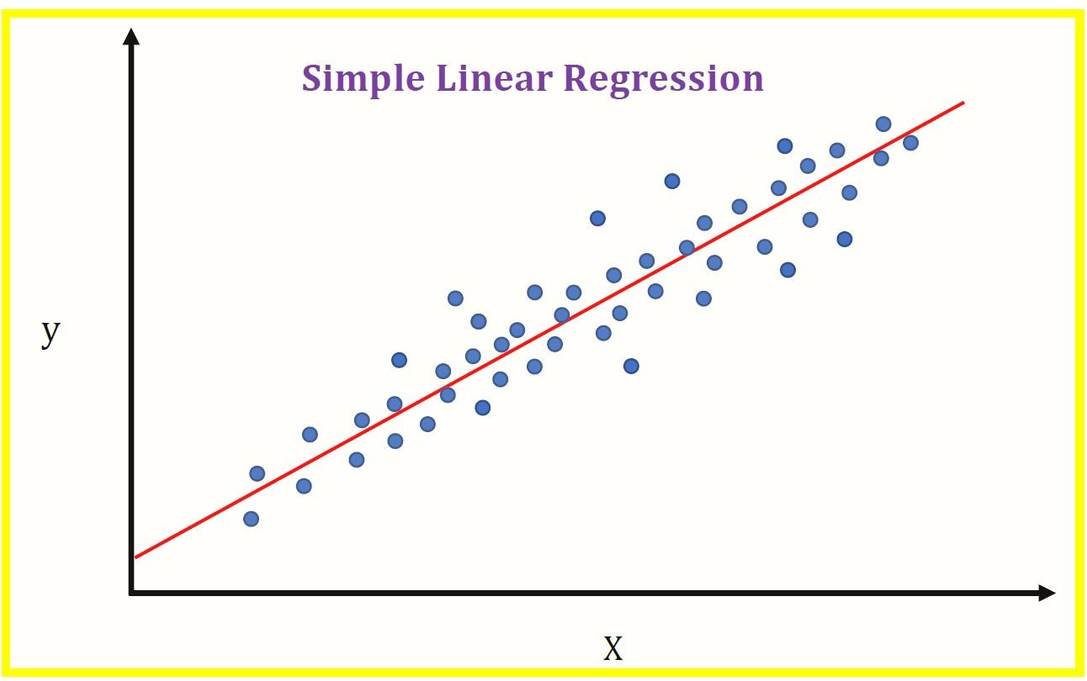
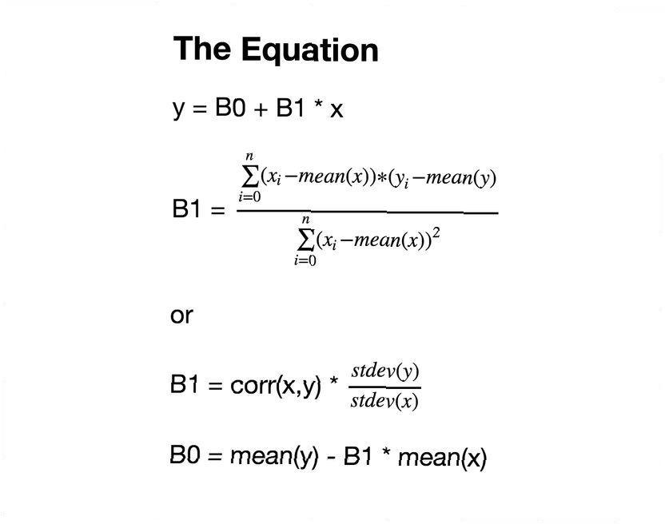
Simple Linear Regression
Simple linear regression is useful for finding relationship between two continuous variables. One is predictor or independent variable and other is response or dependent variable
Source:Wikipedia

Slide 11
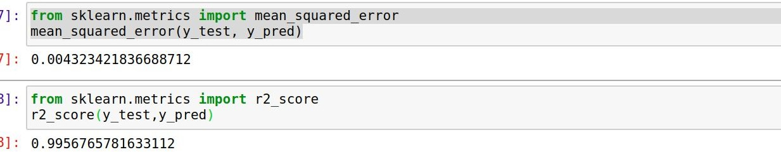
Observation
Accuracy matrix use: mean squared error and R2 score
Although we got very good accuracy but this model requires current day high,low and open values of stock it cannot predict next day values
We can consider this algorithm if we want to predict current day’s closing price
Hence linear regression is not good option for our project as we want to predict next 30 days values

Slide 12
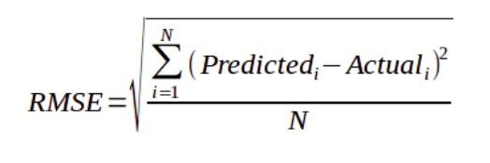
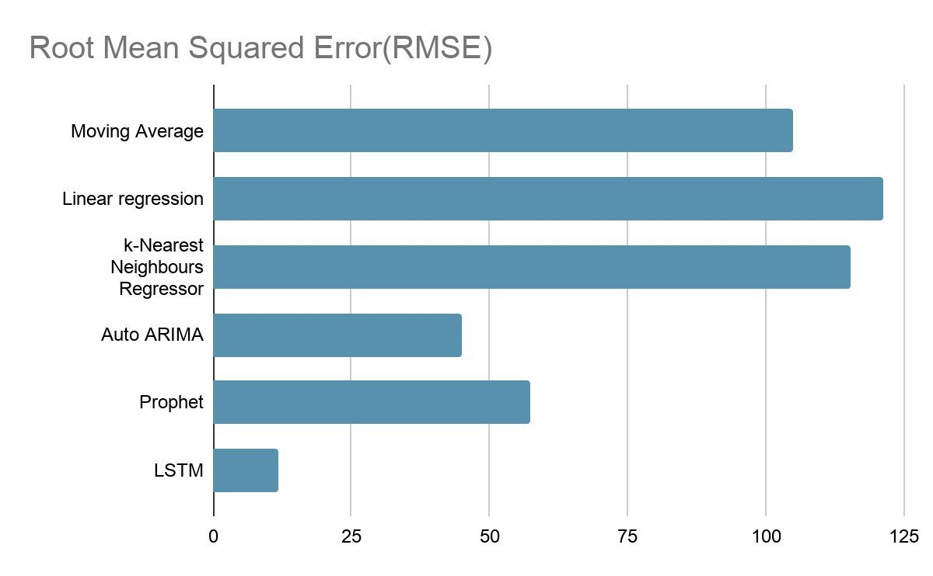
Algorithms
Root Mean Squared Error
Data Source: AnalyticsVidya

Slide 13
Summarising
After reading several articles and watching some youtube videos we conclude that there are various algorithms for time series forecasting out of them LSTM performed well for stock price prediction
Linear regression being linear in nature does not perform well with respect to time however still we can predict price using this algorithm
Auto ARIMA or ARIMA is useful for stationary dataset and because our problem is non-stationary it will not much efﬁcient
For predicting stock price of tommorrow we need to provide today’s opening price,closing price etc which means we need to use previous output as input which is possible in RNN i.e LSTM

Slide 14
Recurrent Neural Network
Recurrent Neural Network are a type of artiﬁcial neural network designed to recognize patterns in sequence of data such as text , genomes, handwriting, the spoken work or numerical time series data emanating from sensors, stock markets and government
y₀
y₁
y₂
w_{y}
^{w}y ^{w}y
h = g (w x + w h + b )
h₀
h₁
h₂
(t) h i (t) y (t-1)
h
y_{(t)} = g_{y}(w_{y} h_{(t)} + b_{y})
w_{i}
w_{i}
w_{i}
x₀
x₁
x₂

Slide 15

Training of Recurrent Neural Network
Recurrent Neural Network
uses
backpropagation algorithm, but it is applied for every time stamp. It is commonly known as Backpropagation Through Time (BTT).
Issues with Backpropagation:
⚫ Vanishing Gradient
⚫ Exploding Gradient

Slide 16

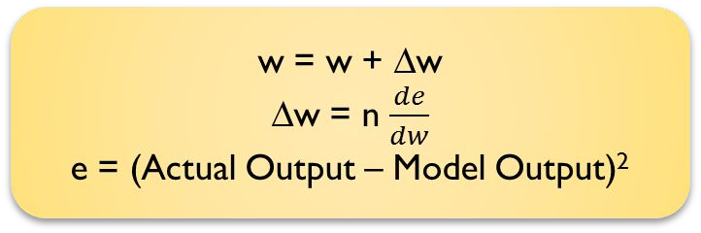
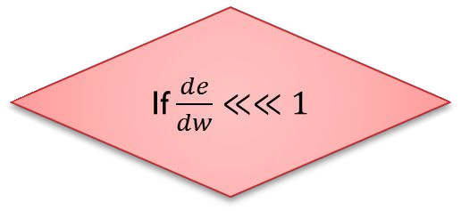

Vanishing Gradient
Backpropagation
∆w <<<<<< 1 w << << << 1

Slide 17
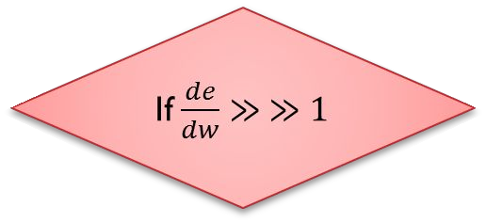
Exploding Gradient
Backpropagation
∆w >>>>>> 1 w >> >> >> 1

Slide 18














Long Short Term Memory (LSTM)
Long Short Term Memory networks – are special kind of RNN
They are capable of learning long-term dependencies
h
^{h}t-1
t-1
^{h}t-1
A
A
tanh
^{x}t-1 ^{x}t-1
^{x}t-1
The repeating module in a standard RNN contains a single layer

Slide 19
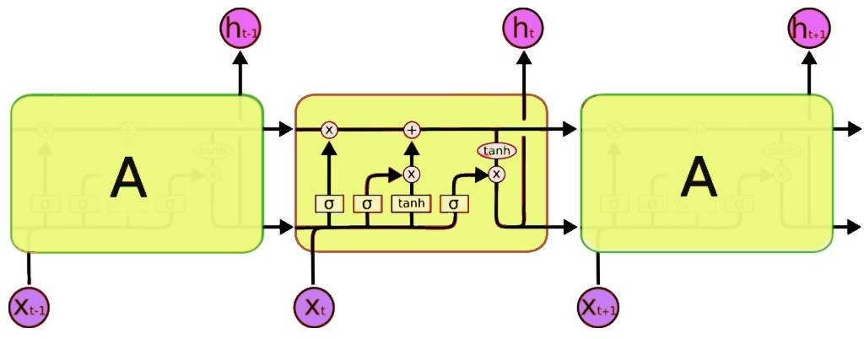
Long Short Term Memory Networks
Source:AnalyticsVidya

Slide 20
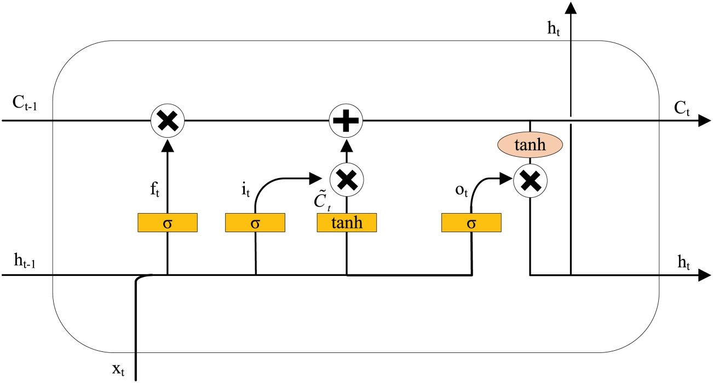
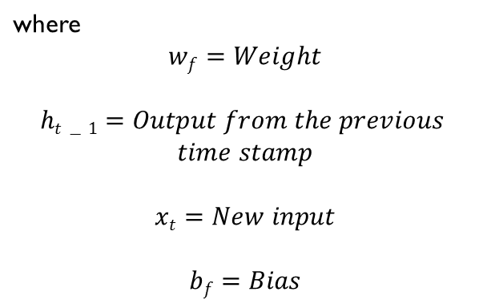
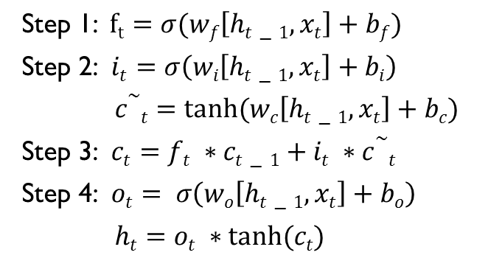
Long Short Term Memory Network

Slide 21
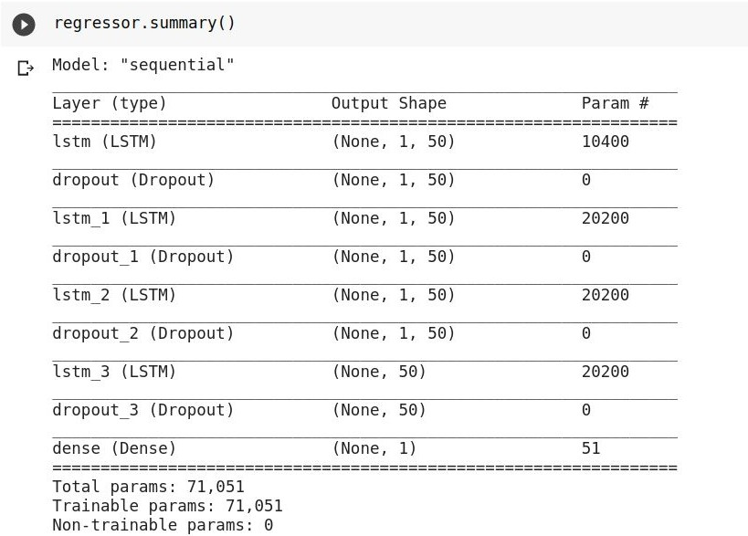
Implementation

Slide 22
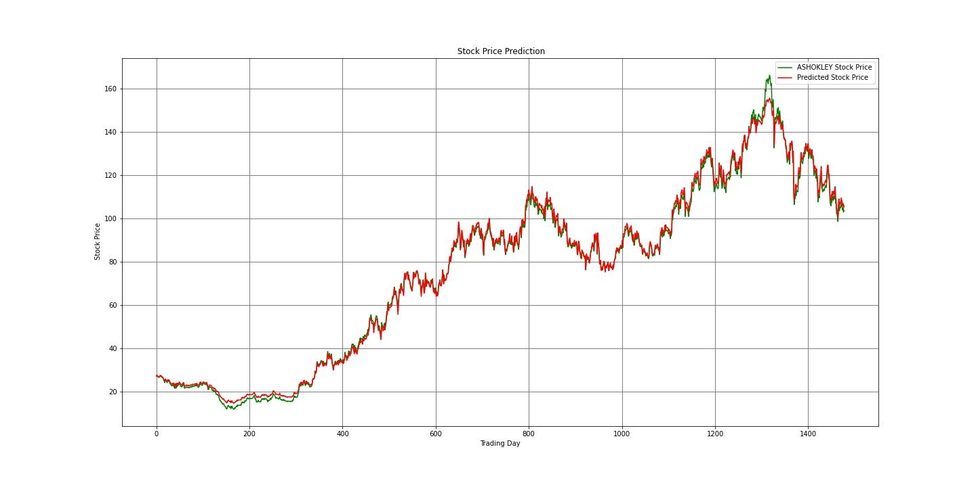
Implementation

Slide 23
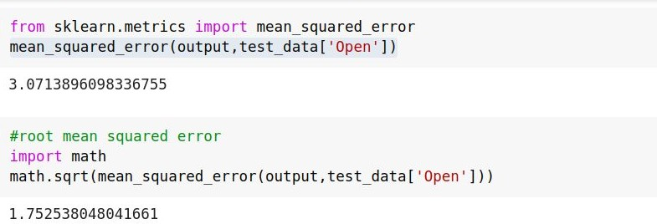
Evaluating Model

Slide 24
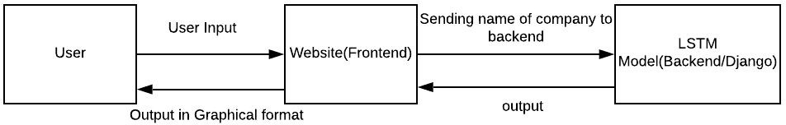
System Design:
Block Diagram

Slide 25
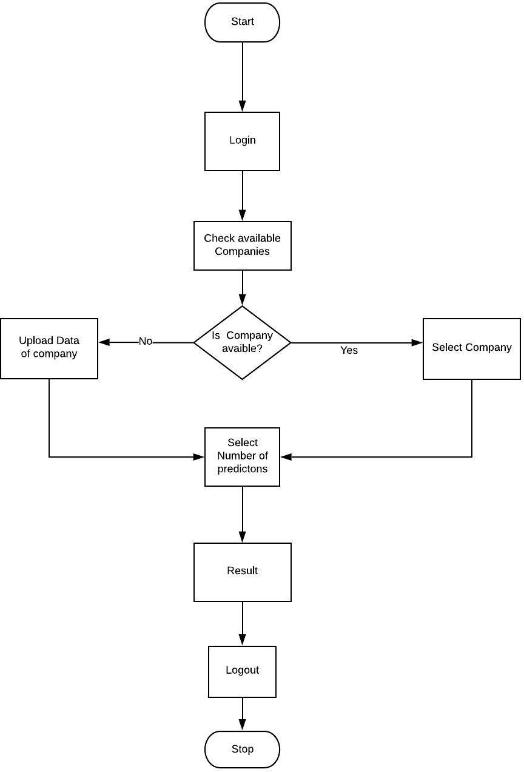
System Design:
Activity Diagram

Slide 26


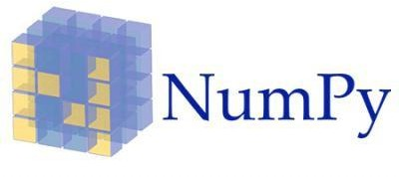




Overview of Our System
Source:Google

Slide 27
Framework for Backend:
Django is a Python-based free and open-source web framework that follows the model-view-controller architectural pattern.
Processing input:
Django based website will take input i.e historical data from user and process it in real time using predeﬁned deep-learning model
Graphical Representation:
Website will produce value of stock in graphical format such as bar charts,line chart,comparison between predicted vs actual,accuracy of prediction etc

Slide 28
Output
Website will give upto next 30 days closing price of stock selected by user in the form of table or graph

Slide 29
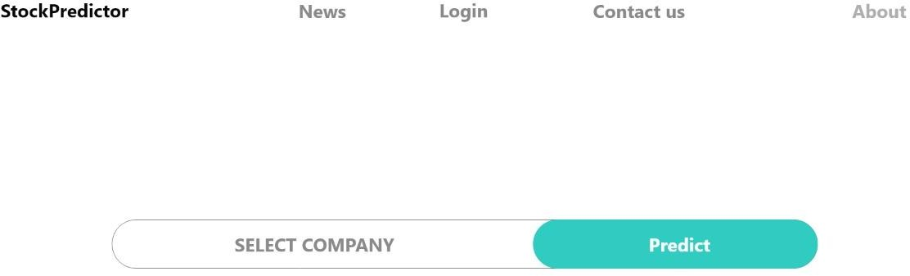
Website User Interface

Slide 30
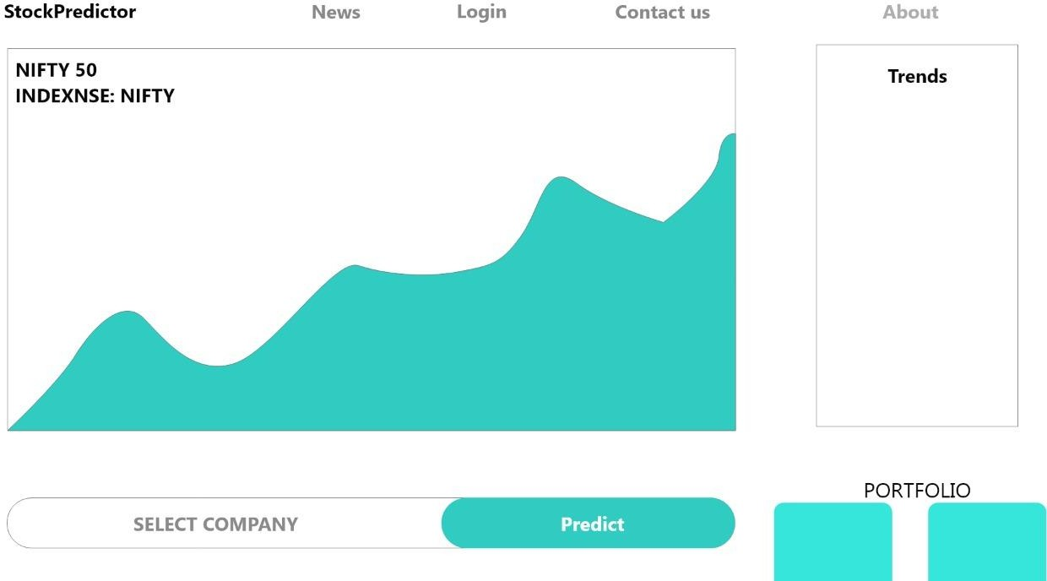
Complete Design

Slide 31
Title | Author | Year | Publication
An overview of time series forecasting models | David Burba | 2019 | Medium.com
Time Series Forecasting Methods in Python | Jason Brownlee | 2018 | machinelearningmastery. com
Stock Prices Prediction Using Machine Learning and Deep Learning Techniques | Aishwarya Singh | 2018 | AnalyticsVidya.com
Stock Market Prediction Using LSTM Recurrent Neural Network | Adil MOGHAR Mhamed,HAMICHE | 2020 | sciencedirect.com

Slide 32
Reference
https://machinelearningmastery.com/time-series-forecasting-methods-in-python-chea t-sheet/
https://www.analyticsvidhya.com/blog/2018/10/predicting-stock-price-machine-learni ngnd-deep-learning-techniques-python/
https://towardsdatascience.com/an-overview-of-time-series-forecasting-models-a2fa 7a358fcb
https://en.wikipedia.org/wiki/Recurrent_neural_network
https://www.analyticsvidhya.com/blog/2017/12/introduction-to-recurrent-neural-net works/
https://www.youtube.com/watch?v=ndz8WKFqu8o
https://www.researchgate.net/publication/340636297_Stock_Market_Prediction_Usin g_LSTM_Recurrent_Neural_Network

Slide 33


